Slide 1
DFM_RAMP_MAGNET_RADIAL_ M1 MAGNETIZED_TE_B747_160-05689-91
Date: 2025/06/24
Rev.: 91

Slide 2
B747 | Revision List
Rev. | Description | Date
01 | Initial Release | 2024/12/05
1.1 | On page 11, the wire saw cutting method was changed from straight lines to arcs, and the wire saw parameters were changed; | 2024/02/10
02 | Update 2D Drawing | 2025/03/04
03 | Update 2D Drawing | 2025/05/09
04 | Update 2D Drawing | 2025/06/20
91 | Page 17 has been updated to automatic magnetization & laser marking line | 2025/06/30

Slide 3
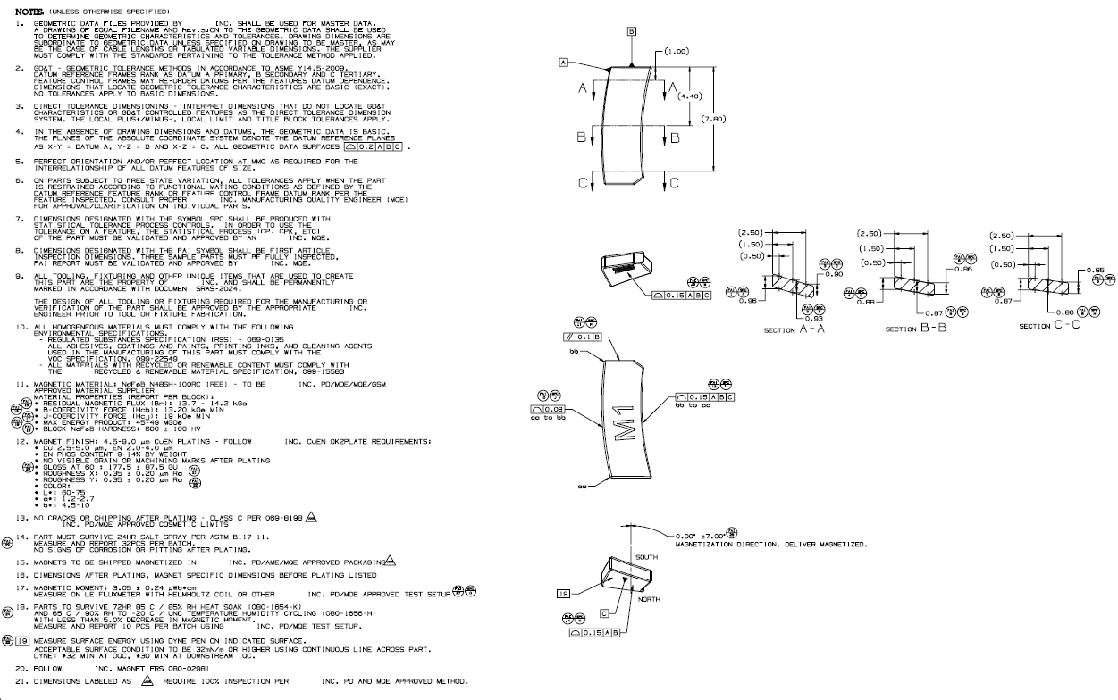
B747 | Product Information

Slide 4
B747 | Process Flow Chart
Block Magnet
1st Wire Saw
1st Double Side Grinding
2nd Wire Saw
2nd Profile Grinding
3rd Wire Saw
1st Profile Grinding
2nd Double Side Grinding
3rd Profile Grinding
Tumbling
Plating
AOI Inspection
Packaging
Inspection
Laser
Magnetizing

Slide 5
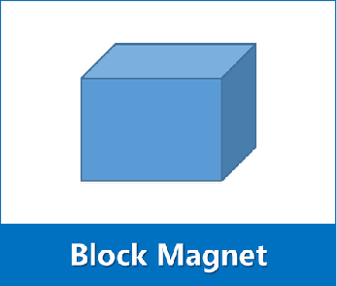
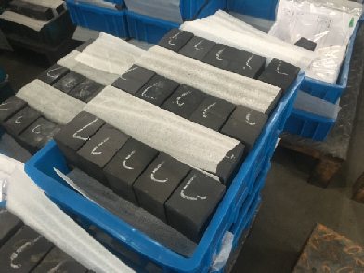
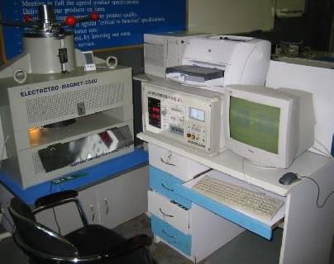
B747 | Process Description _ Block
Block magnet with proper properties and dimension
Control Point:
Material Grade: N48SH-100RC(REE)
Br: 13.7-14.2kGs
Hcb: ≥ 13.2 kOe
Hcj: ≥ 19kOe
(BH)max: 45-49MGOe
Block magnet size: 57 × 43 × 35
Magnetic Properties Tester

Slide 6
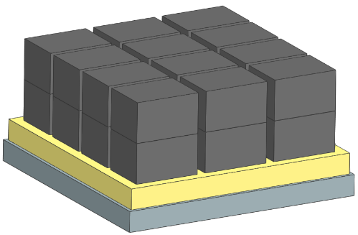
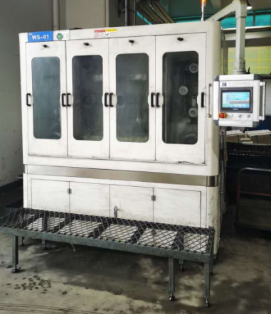
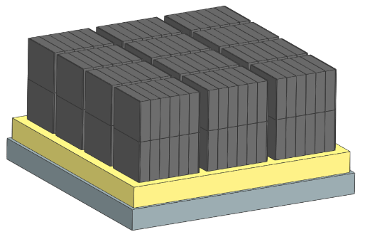
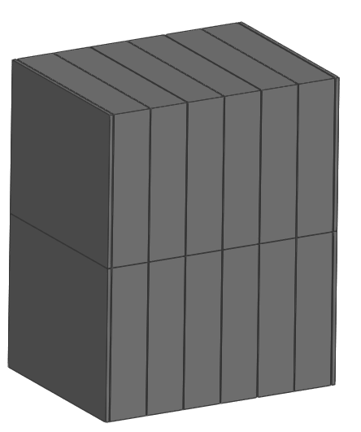
B747 | Process Description _ 1st Wire Saw
1st Wire Saw Parameter
Machine related | 型号 /Model | CX2121(CHT690)
 | 滚轮转速 /Wheel Speed | 800-1200m/min
 | 线径 /Wire Diameter | 0.25mm
 | 主进给速度 /Main Feeding Speed | 0.3-0.5mm/min
Process related | 料块摆放数量 /Block Qty | 2 × 3 × 4 × 2
 | 切片尺寸 /Slicing Dimension | 8.93±0.04 mm
 | 冷却液 /Coolant | DX-7A
Fixture related | L直角靠块 /Right-angle Block | 专用夹具 /Customized Made
 | 千分尺 /Micrometer | 0-25mm
 | 大理石底板 /Marble platform | 专用定制 /Custon Made
Material utilization ratio | 94%

Slide 7
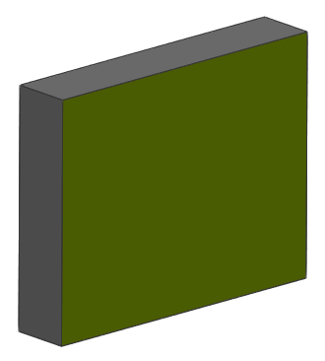
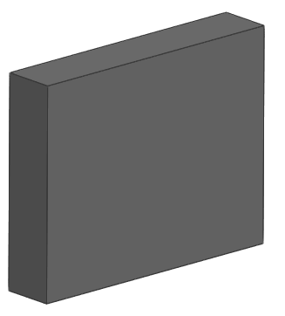
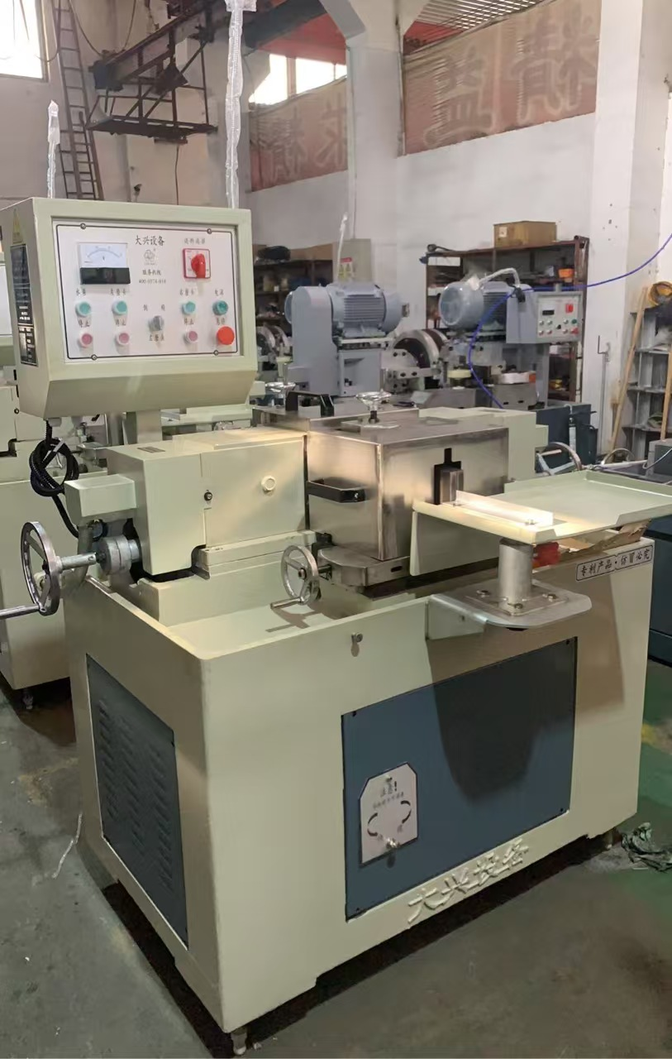
B747 | Process Description _ 1st Double Side Grinding
1st Double Side Grinding Parameter
Machine related | 型号/Model | M7625(M7635)
 | 砂轮材质/Wheel Material | 树脂砂轮 /Resin
 | 砂轮规格/Wheel SPEC | 250(350)x129x35
Process related | 研磨前尺寸/ Dimension Before Grinding | 8.93 × 43 × 35
 | 研磨后尺寸/ Dimension After Grinding | 8.809±0.02 × 43 × 35
 | 成型磨冷却液/ Coolant | ES232
Fixture related | 固定导槽/ Fixed Guide | 导轨 /Slideway
 | 千分尺/ Micrometer | 0-25mm
Material utilization ratio | 98.65%

Slide 8
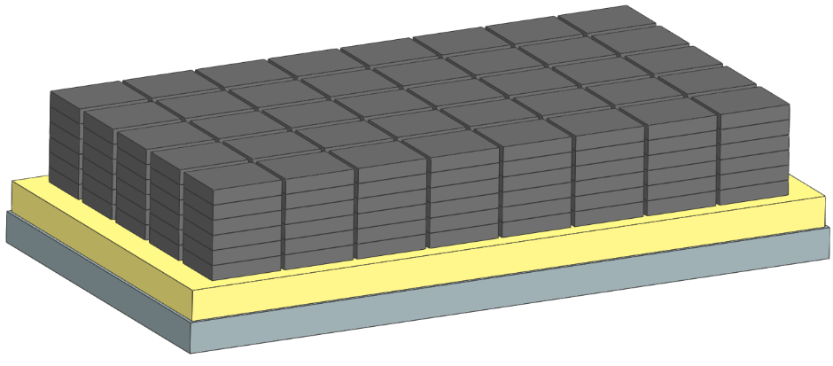
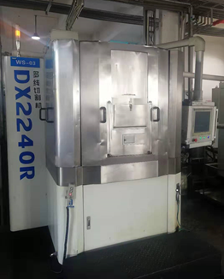
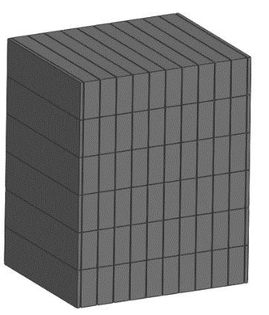
B747 | Process Description _ 2nd Wire Saw
2nd Wire Saw Parameter
Machine related | 型号/Model | DX2240(DX2260,CX680)
 | 滚轮转速/Wheel Speed | 800-1200m/min
 | 线径/Wire Diameter | 0.2mm
 | 主进给速度/Main Feeding Speed | 0.3-0.5mm/min
Process related | 料块摆放数量/ Block Qty | 6 × 8 × 5
 | 切片尺寸/ Slicing Dimension | 3.93±0.04 mm
 | 冷却液/ Coolant | DX-7A
Fixture related | L直角靠块/ Right-angle Block | 专用夹具 Custom Made
 | 千分尺/ Micrometer | 0-25mm
 | 大理石底板/Marble platform | 专用定制 Custon Made
Material utilization ratio | 91.4%

Slide 9
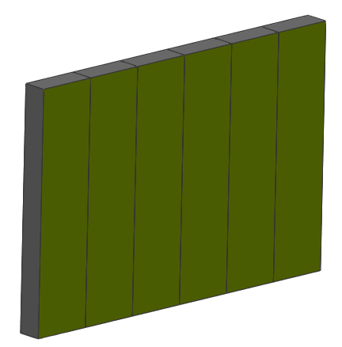
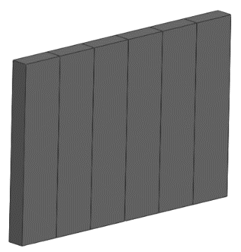
B747 | Process Description _ 2nd Double Side Grinding
2nd Double Side Grinding Parameter
Machine related | 型号/Model | M7625(M7635)
 | 砂轮材质/Wheel Material | 树脂砂轮 /Resin
 | 砂轮规格/Wheel SPEC | 250(350)x129x35
Process related | 研磨前尺寸/ Dimension Before Grinding | 8.809 × 3.93 × 35
 | 研磨后尺寸/ Dimension After Grinding | 8.809 × 3.825±0.02 × 35
 | 成型磨冷却液/ Coolant | ES232
Fixture related | 固定导槽/ Fixed Guide | 导轨 /Slideway
 | 千分尺/ Micrometer | 0-25mm
Material utilization ratio | 97.33%

Slide 10
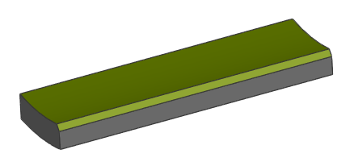
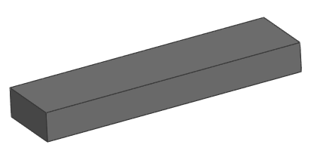
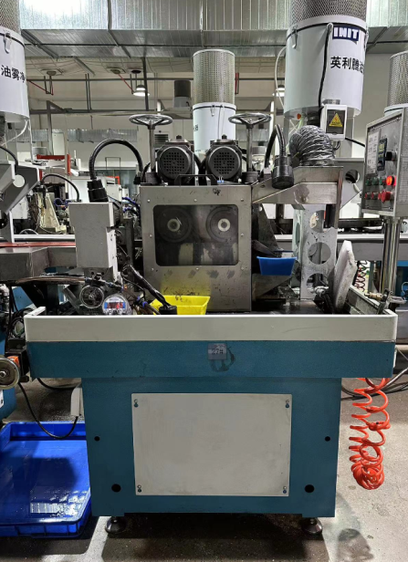
B747 | Process Description _ 1st Profile Grinding
1st Profile Grinding Parameter
Machine related | 型号 /Model | PG160
 | 砂轮材质 /Wheel Material | 金刚砂 /SiC
 | 砂轮规格 /Wheel SPEC | D160
Process related | 研磨前尺寸 /Dimension Before Grinding | 8.809 × 3.825 × 35
 | 研磨后尺寸 /Dimension After Grinding | 8.809 × (R21.5 / R24.5 x 3) × 35
 | 成型磨冷却液 /Coolant | ES232
Fixture related | 固定导槽 /Fixed Guide | 专用导轨 /Customized Slideway
 | 影像测试仪 /Image Tester | OMM
Material utilization ratio | 78.38%

Slide 11
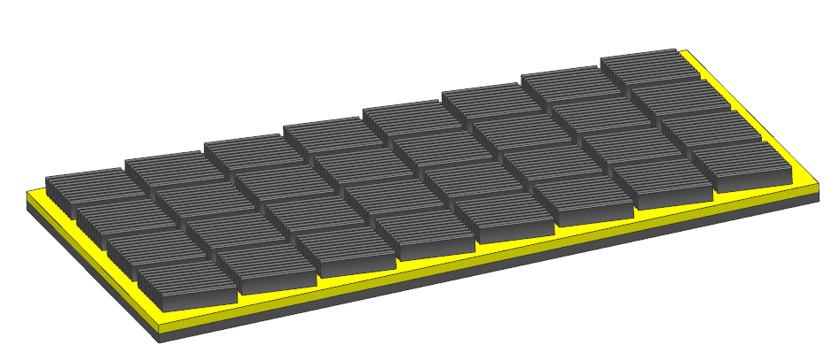
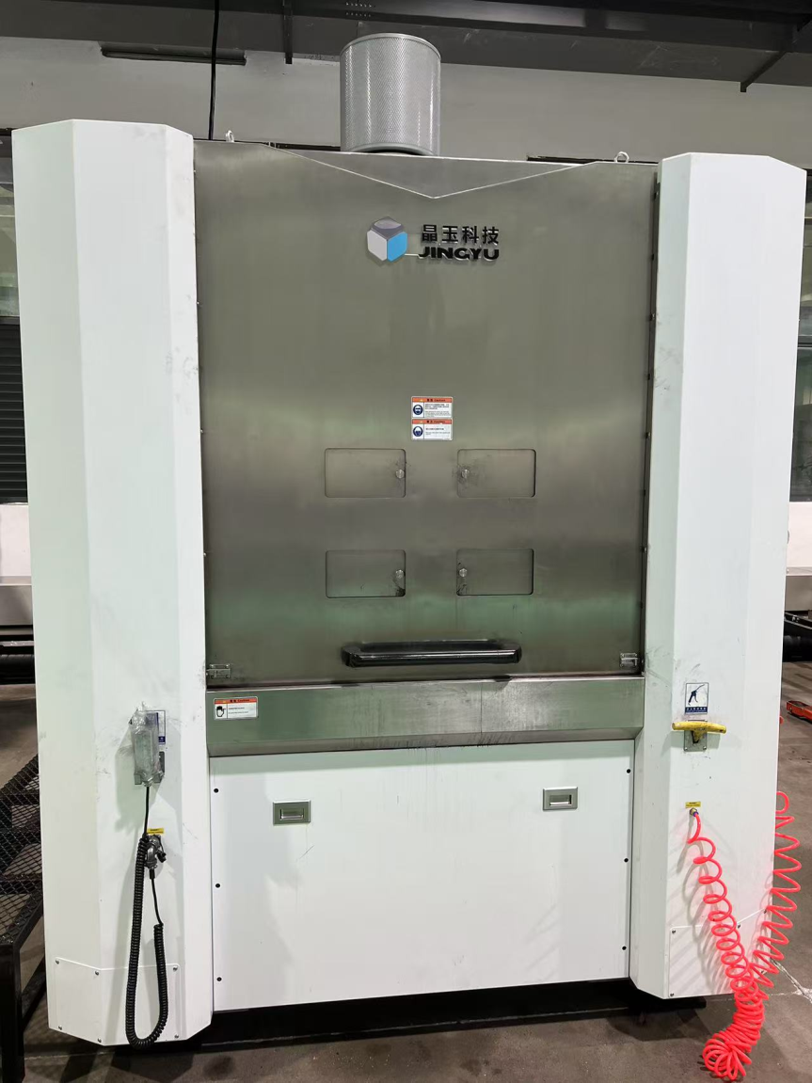
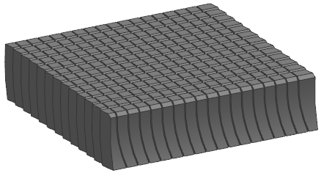
B747 | Process Description _ 3rd Wire Saw
3rd Wire Saw Parameter
Machine related | 型号/Model | SDX1160MHR
 | 滚轮转速/Wheel Speed | 1000-1600m/min
 | 线径/Wire Diameter | 0.18mm
 | 主进给速度/Main Feeding Speed | 0.3-0.5mm/min
Process related | 料块摆放数量/ Block Qty | (1 × 10) × 8 ×4
 | 切片尺寸/ Slicing Dimension | 1.60±0.04 mm
 | 冷却液/ Coolant | GD260-A
Fixture related | L直角靠块/ Right-angle Block | 专用夹具 Custom Made
 | 千分尺/ Micrometer | 0-25mm
 | 大理石底板/Marble platform | 专用定制 Custon Made
Material utilization ratio | 88.18%

Slide 12
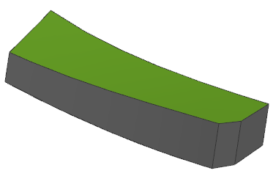
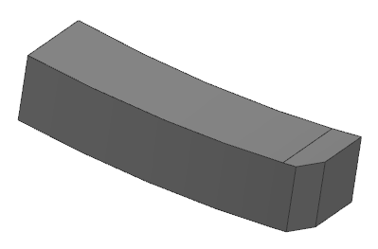
B747 | Process Description _ 2nd Profile Grinding
2nd Grinding parameter
Machine related | 型号/Type | Grinding Machine With Two Grinding Wheels
 | 砂轮材质/Grinding Wheel Material | 金刚砂/Emery
 | 砂轮规格/Grinding Wheel Specification | D160
Process related | 研磨前尺寸/Dimension before Grinding | R24.5 x R21.5 x 3 x 8.81 x 1.60
 | 研磨后尺寸/Dimension after Grinding | R24.5 x R21.5 x 3 x 8.81 x Inner Arc
 | 成型磨冷却液/Coolant for Profile Grinding | M6
Fixture related | 固定导槽/Fixed Guide | 专用导轨/Customized Slideway
 | 影像测试仪/Image Measurement Instrument | OMM
Material utilization ratio | 74.05%

Slide 13
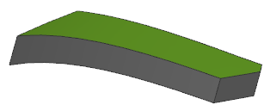
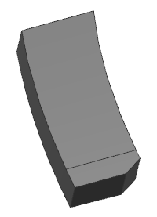
B747 | Process Description _ 3rd Profile Grinding
3rd Grinding parameter
Machine related | 型号/Type | Grinding Machine With Two Grinding Wheels
 | 砂轮材质/Grinding Wheel Material | 金刚砂/Emery
 | 砂轮规格/Grinding Wheel Specification | D160
Process related | 研磨前尺寸/Dimension before Grinding | R24.5 x R21.5 x 3 x 8.81 x Inner Arc
 | 研磨后尺寸/Dimension after Grinding | R24.5 x R21.5 x 3 x 8.81 x Inner Arc / Outer Arc
 | 成型磨冷却液/Coolant for Profile Grinding | M6
Fixture related | 固定导槽/Fixed Guide | 专用导轨/Customized Slideway
 | 影像测试仪/Image Measurement Instrument | OMM
Material utilization ratio | 81.26%

Slide 14
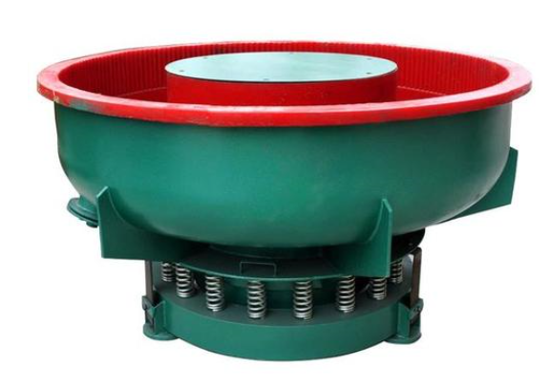
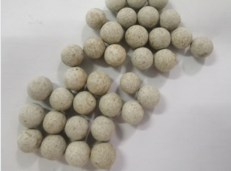
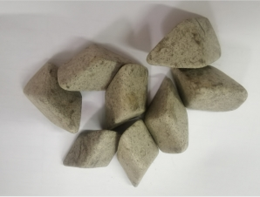
B747 | Process Description _ Tumbling
Tumbling Parameter
Machine related | 型号/Model | LZG200
 | 类型/Type | Vibrator
 | 容量/Volume | 200L
 | 转速（电压/频率)/speed | 45-50Hz
 | 振幅/Amplitude | -
Process related | 磨石VS磁钢配比 | 75±5 : 35±5
 | 装载量（容量L）/Loadage | 35±5kg
 | 振磨时间/Time | 10~12 hrs
 | 磨石规格/size | Φ16圆球 & 18*18斜三角
 | 磨石材质/Material | SiC
Fixture related | 过滤网/Filter screen | -
Remove the sharp edge of magnet

Slide 15
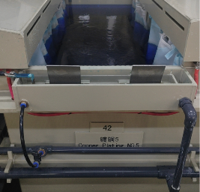
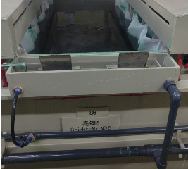
B747 | Process Description _ Plating (CU+EN Plating)
Plating Process Flow Chart
Ultrasonic degreasing
Acid pickling
Activation
Copper plating
Activation
EN plating
Main Process:
Copper plating
EN plating
1. Plating layer thickness
Cu: 2.5-5 μm
2. Qty.: 4~5kg /1barrel /70-90min
1. Plating layer thickness
EN: 2-4 μm
2. Qty.: Qty.:4~5kg /1barrel /70-90min

Slide 16
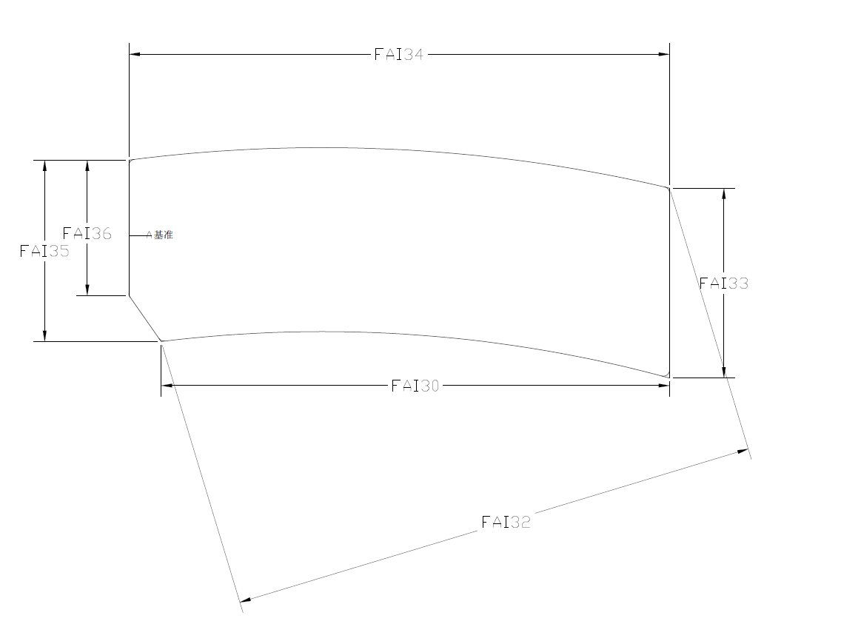
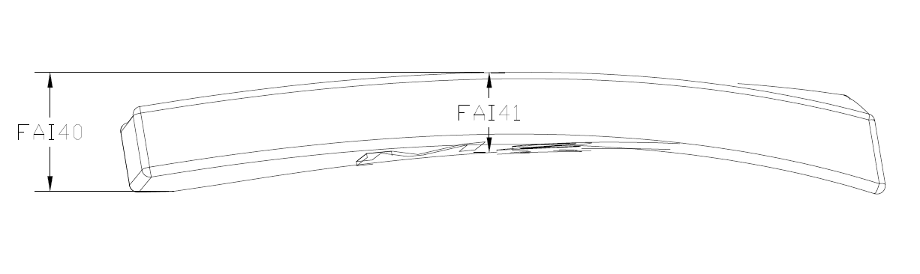
B747| Process Description _ AOI Inspection
AOI Inspection

Slide 17
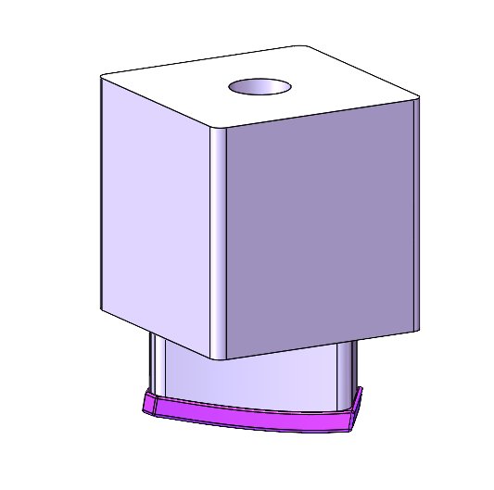
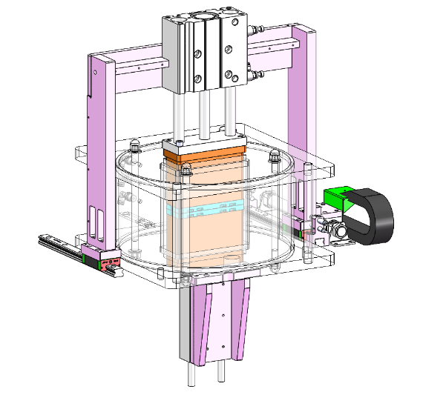
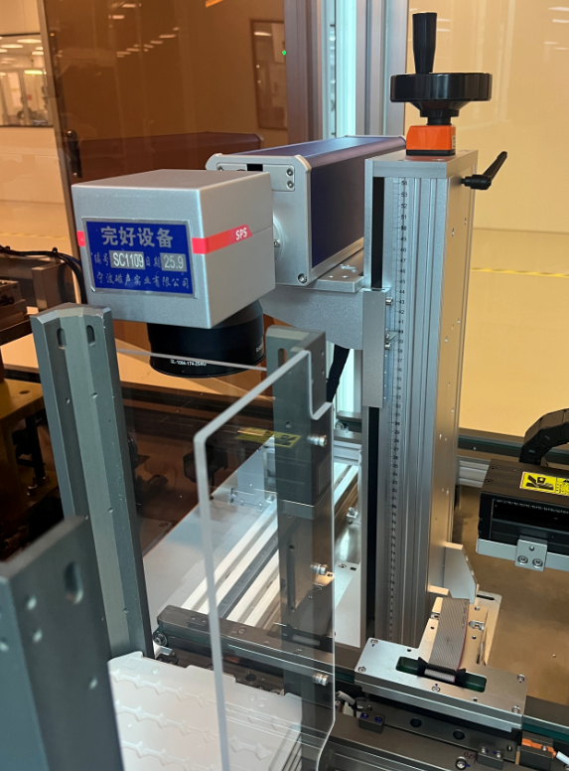
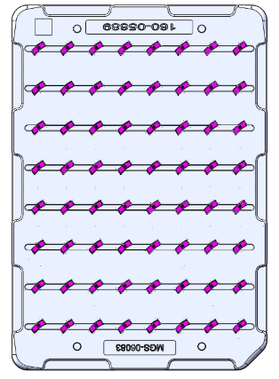
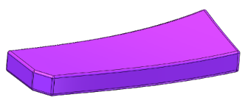
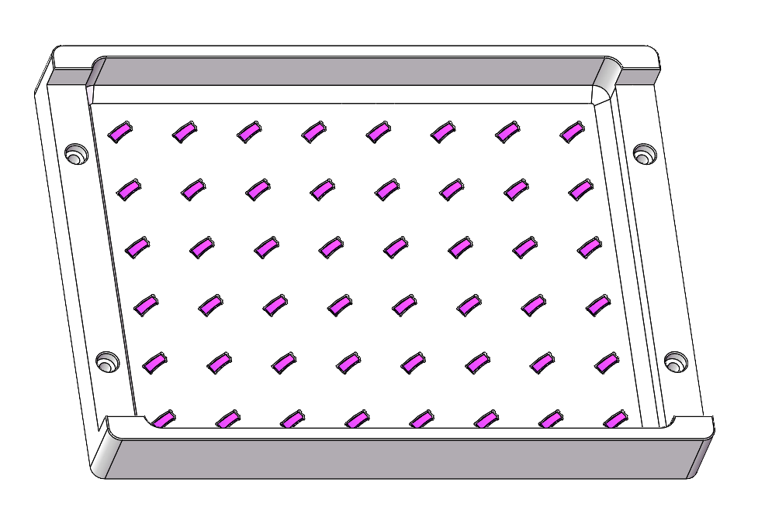
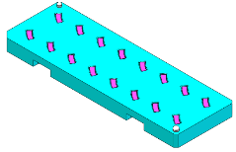
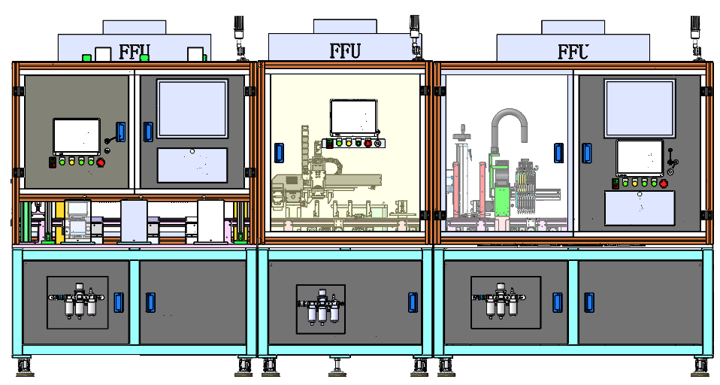
B747| Process Description _ Magnetizing/ Laser Marking
Loading Magnet
Magnetizing
Laser Marking
Load the Magnet into the tray
Laser Marking Parameter
Machine related | Type/型号 | GM-F-D-XT-20
 | Output/输出功率 | 20W
 | Frequency/频率 | 80KHZ
Processing related | Speed/速度 | 800-1300mm/s
 | Q Frequency/Q频率 | 45-60KHz
 | Jump Speed/空跳速度 | 3000mm/s
 | Power%/使用功率% | 25-45%
 | Filling Spacing/填充间距 | 0.025-0.05mm
Contoured Nozzle
Magnetizing coils
Automated Equipment Flow chart
Flexible Vibrating Plate
Magnetizing Parameter
Magnetizing machine Type | KCJ-35M
Magnetizing coil Type | TCG-S
Magnetizing coil Size | 110*75*150 mm
Magnetizing Voltage | 3000 V
Magnetizing Capacitance | 9000μF
Flex Vibration Feeder Module
Magnetizing module
Laser Marking & Unloading Module
Automated Magnetizing & Laser Marking Line
1800mm
1600mm
1000mm
1400mm
(Picture for reference only)

Slide 18
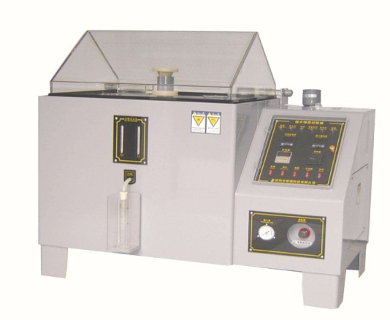
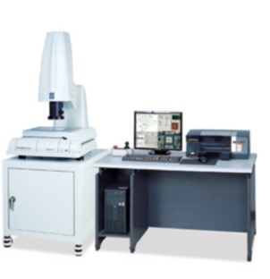
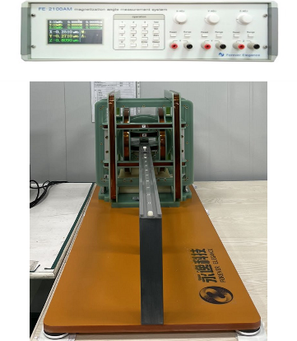
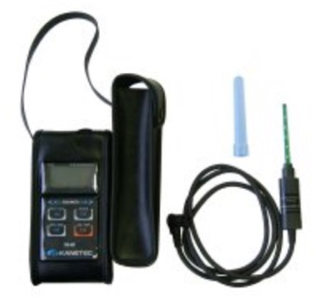
B747| Process Description _ Inspection Device
XRF Coating Test
SST Test
OMM Dimension test
Fluxmeter+ Helmholtz coil
Flux density Test
Polar Pen

Slide 19
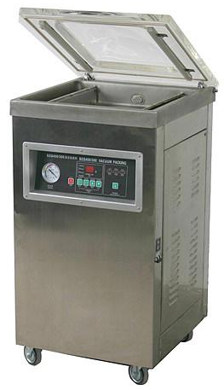
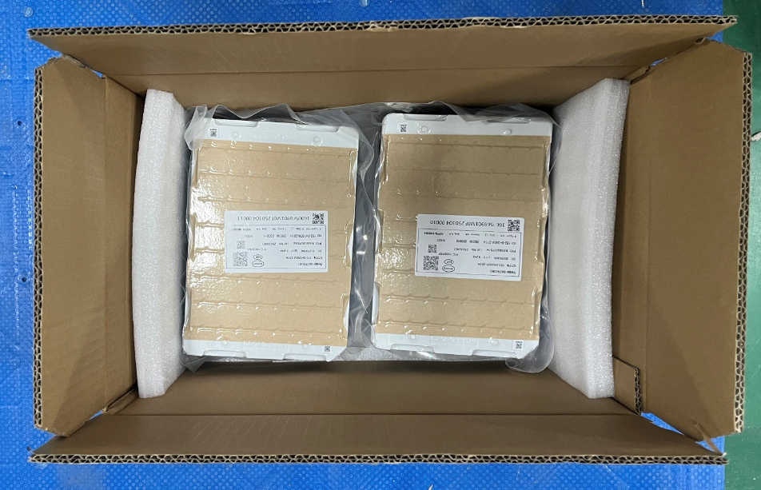
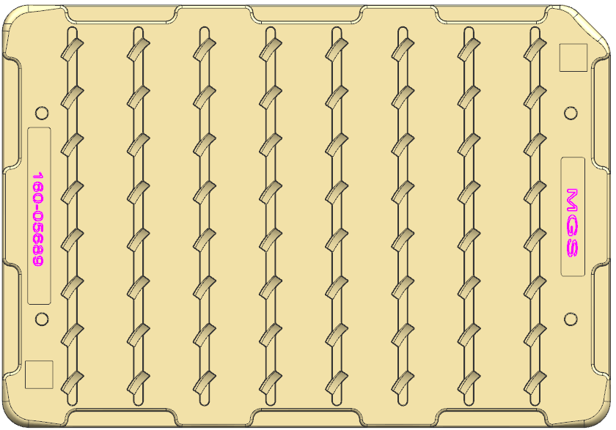
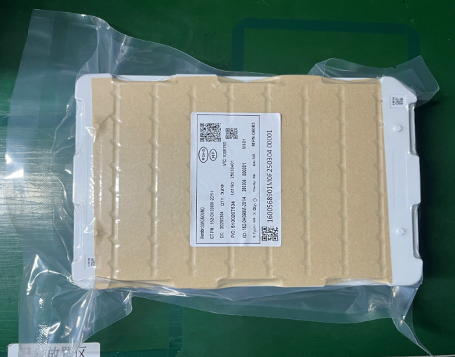
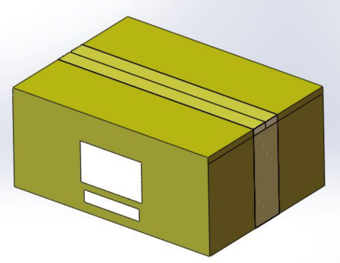
B747 | Process Description _ Packaging
64*Products
1*Packaging Tray
Place the products into tray
Qty: 64 Pcs
Put 5 trays into a Vacuum bag
Qty:64 Pcs/Tray * 30 Tray =1920pcs

Slide 20
Thank you !

